Slide 1
Easy-Eight
Christy Bergevin Riley Campbell Nate Fagrey Logan Larson

Slide 2
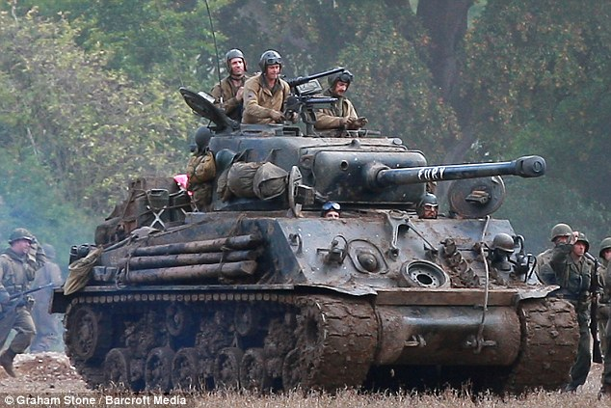

Introduction:
Easy-Eight:
Nickname for US M4 Sherman tank
during WW2.

Slide 3
Outline:
Strategies/Goals
Backlog/User Stories
Sprints
Tank Architecture
Testing
Successes
Issues
Questions?

Slide 4
Strategies and Goals:
Initial
Tank will shoot laser bolts
Our tank will implement the Markov Chain Theory for a tank movements
Our tank will see the whole map in order to make the best decision
Our tank will put most special points into Radar to kill enemies first
Our tank will keep track of where its been

Slide 5
Strategies and Goals
Final Goals
Our tank will keep track of where its been
Handle multiple enemies
Handle not being in line to shoot
Efficient searching algorithm to traverse the whole map
Spread out AP to maximize our lethality
We will have an evade option

Slide 6
User Stories:
Example:
Target User Story:
As a controller of a tank, I need to be able to locate and destroy Targets anywhere on the field, so I can pass requirements and win.
Description:
A tank will need to be able to navigate a play-field to find all targets and destroy them. It will therefore need to be able to make decisions at every turn to find them.
Time to Complete: 1 week
Completed/Acceptance?: When a tank can navigate any gamefield destroying all targets.
Priority?: 1 (Needs to work).

Slide 7
User Stories:
Example Cont.
User Stories as a Developer:
As a developer, I will need to be able to convert the grid cells to a graph, in order to make movement/attack decisions.
Description: We will need to be able to traverse any map looking for targets. We will probably need to implement some searching algorithm to find the Targets efficiently. We will also implement the radar first strategy.
Time to Complete: 1 week
Completed/Acceptance?: When a tank can navigate any gamefield destroying all targets.
Priority?: 1 (Needs to work, as this will be algorithm will be used on other requirements).

Slide 8
Sprints:
1 Week Feature Sprints
Sprint 1: 03/18-03/25
All user stories made, which creates our project backlog. Adding Turret, Mouse, Target, and senty objects to the code if there not already.
Sprint 2: 04/01 - 04/08 Nate and Riley would create a Shortest Path Algorithm, while Logan and Christy came up with a a searching algorithm based off of Prims and Dikstra’s.
Sprint 3: 04/15 - 04/22 Move function must work and find targets.
Sprint 4: 04/22 - 04/29 Improve Attack and implement SOLID principles.

Slide 9
Architecture:
Basic Algorithm:
Scan for Enemies
If in line to shoot
If too many Enemies
Closest enemy
If no Enemy
Update map
Divide and Search Algorithm

Slide 10
Divide and Search Algorithm:
3 |  |  | 3 |  |  | 3 |  |  | 6
 |  |  |  |  | R
3 |  |  | E |  | R | 4 |  |  | 6
 |  |  |  |  | R
3 |  |  | 3 |  |  | 3 |  |  | 6
6 |  |  | 6 |  |  | 6 |  |  | 9
Keeps track of where we have been
Splits graph by a adjustable step
Weighted by a bfs
Resets when all is found

Slide 11
Data Structures:
Was able to everything in our tank class
Used a priority queue for the Divide and Search Algorithm
Kept all maps in 1D vector form, but still navigated them like a graph
Split up up Move and Attack interfaces into multiple small functions

Slide 12
Testing:
Used Catch.hpp
Mostly did Unit Tests, testing the individual parts of our move and attack
A few integration tests
For tank searching, best test was printing out a mock map of what the tank could see and where it wanted to go.

Slide 13
Successes:
Was able to constantly work on the tank throughout the entire time
Was able to implement the searching Algorithm we wanted
Was able to navigate most playfields to find targets, mice, turrets, etc…
Added special conditions for move and attack

Slide 14
Failures/Problems:
The level of testing was not what we wanted
Dividing up work could have been better
Overestimated our ability to complete user story time requirements
Our tank struggled in PvP until the recently
Was not able to fully implement the evade function

Slide 15
Demo

Slide 16
Questions???

